Slide 1
Design Choices
TTS Accessibility Guild
GSA | Technology Transformation Services
Notes:
Robert

Slide 2
Homework
What was your experience like testing the two scenarios from the TTS page?
Did you find any accessibility or usability issues?
Notes:
Robert

Slide 3
Why do design choices matter?
Notes:
Robert

Slide 4
The way that you design a product affects, well, everyone. The visual and interaction design choices that you make naturally have implications for every class of disability.
Notes:
Robert / Pia

Slide 5
Color
Notes:
Nikki / Claire

Slide 6
People can have different disabilities around color, and perception of color varies in all humans. And, color perception can change with age.

Slide 7
Color perception is situational — it’s affected not just by the cones and rods in your eyes, but also screen glare, ambient light, eye fatigue, and many other factors.

Slide 8
1/ Make sure all colors have high contrast.
Notes:
Nikki

Slide 9
Contrast
Color
Images and diagrams used to convey meaning should have a contrast ratio of 3:1.
All text, including inside diagrams, should have a contrast ratio of 4.5:1. Really big text (18pt normal or 14pt bold) can have a contrast ratio of 3:1.
UI elements should have a contrast ratio of 3:1.

Slide 10
Text
All text, including images of text, must meet the minimum contrast requirements specified by WCAG 2.0 Level AA. Those minimum contrast ratios are:
Normal Text 4.5:1
Large Text: 3:1
Note: Large text is defined as type that is sized at least 18 points (24px) normal weight or 14 points (19px) bold.

Slide 11

This text has a contrast ratio of 5.88:1! It’s very readable.
Text with a 4.5:1 or greater contrast ratio can be easily read by nearly everyone!

Slide 12

This text has a contrast ratio of 1.84:1! For some of us, it’s easy to read. For others… not so much. :(
Text with contrast ratio of less than 4.5:1 can be hard for people to read. Large text is generally ok at a 3:1 contrast ratio, but this example doesn’t meet that either.

Slide 13
How to test
Option 1: Use the WAVE toolbar to determine if any text fails the automated check for contrast.
Option 2: (If any contrast values cannot be automatically calculated) Use the Colour Contrast Analyser application to check the contrast ratio between foreground and background colors of non-text (image) content.
You can cite WCAG 1.4.3 Contrast (Minimum) in your bug report for any instances of text contrast less than 4.5:1 (or 3:1 for large text).

Slide 14
Images & diagrams
Non-text content (like diagrams) should have a color contrast ratio of 3:1. While this isn’t required to pass a WCAG 2.0 AA scan (the current Section 508 standard), it’s easy to do and makes your content more accessible.

Slide 15
Good example – diagram contrast
All parts of this diagram have a 3:1 or better contrast ratio against the background
Do you need a blockchain?
Do you need a database?
Do many people need to write to it?
Do those people trust each other?
You don’t need a blockchain
yes
yes
yes
no
no
no
You don’t need a blockchain
You don’t need a blockchain
Do they have one person in common that they trust?
You don’t need a blockchain
yes
no
Ok, you need a blockchain

Slide 16
Good example – diagram contrast, explained
All parts of this diagram have a 3:1 or better contrast ratio against the background
13.4:1
6.5:1

Slide 17
Bad example – diagram contrast
This diagram has less than 3:1 contrast
Number of times “blockchain” mentioned in quarterly sales meeting:
30
25
20
15
10
5
0
Steve Natalie Wilson Indira Yousef

Slide 18
Bad example – diagram contrast, explained
This diagram has less than 3:1 contrast
1.1:1
1.4:1
1.3:1
1.2:1
1.2:1
Notes:
Consider using patterns instead

Slide 19
How to test
Use the Colour Contrast Analyser application to check the contrast ratio between foreground and background colors of non-text (image) content.
If anything is less than 3:1, you can cite WCAG 1.4.11 Non-text Contrast in your bug report.

Slide 20
UI elements
Functional or meaningful UI elements without equivalent text nearby (e.g. buttons, icons, form controls, etc.) should have a minimum contrast ratio of 3:1.
If a graphic is needed to understand the content or functionality of the webpage then it should be perceivable by people with low vision or other impairments without the need for contrast-enhancing assistive technology. - WCAG 1.4.11 - Understanding Non-text Contrast

Slide 21
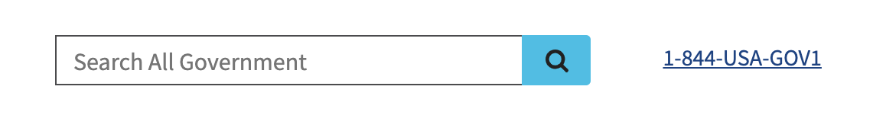
Good example – search field contrast
The search box has a border with an 8.7:1 contrast ratio against the background, which makes it easy for everyone to differentiate.
8.7:1
9.6:1

Slide 22
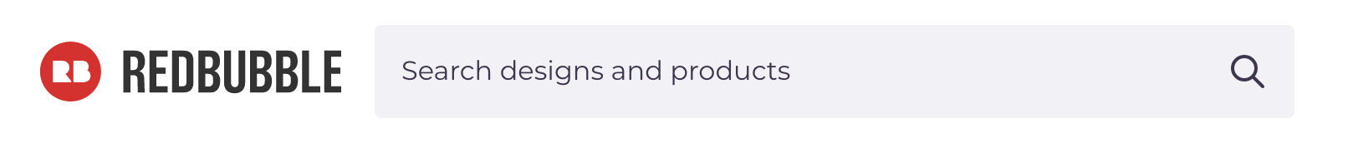
Bad example – search field contrast
This search box has a contrast ratio of 1.2:1 — not all users will be able to clearly differentiate the search field from the background.
1.2:1

Slide 23
How to test
Use the Colour Contrast Analyser application to check the contrast ratio between foreground and background colors of non-text (image) content. If any items have less than a 3:1 ratio, you’ve identified an accessibility problem.
You can cite WCAG 1.4.11 Non-text Contrast in your bug report.

Slide 24
2/ Don’t rely on color alone to denote meaning.
Notes:
Robert

Slide 25
Color by itself doesn’t actually mean anything.

Slide 26
Cultural meanings of color vary. For example, in the USA weddings are associated with the color white, whereas in China weddings are associated with the color red.

Slide 27
Not everyone can differentiate colors well, so don’t use color alone for meaning. Add another way to distinguish things.

Slide 28
When you do use color to help identify design elements, don’t rely on hue alone. Make sure that the value, or lightness, of your colors can be easily differentiated.

Slide 29
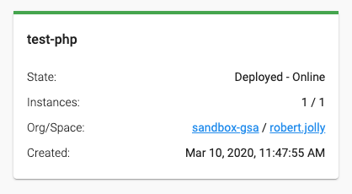
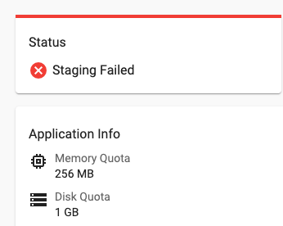
Good example – color not used alone for meaning
Status/state is indicated using color with label (deployed-online image) and color with shape/icon (staging-failed image).

Slide 30
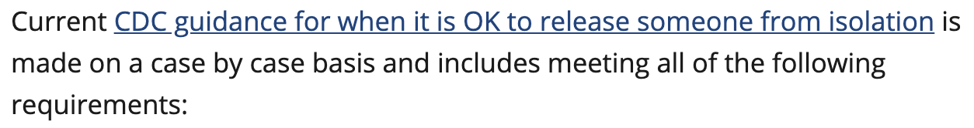
Good example – link color not used alone for meaning
Links are differentiated using both color and an underline. Users who have trouble differentiating colors can rely on the underline to identify links.

Slide 31
Bad example – link color alone for meaning
In Slack, links are differentiated using color alone. The link color has low contrast with non-link text, making it hard for some people to identify a link.
2.73:1

Slide 32
How to test
Determine if there are any instances in the page or app where color is used by itself to convey meaning or information.
If there are any of these issues, you can cite WCAG 1.4.1 Use of Color in your bug report.

Slide 33
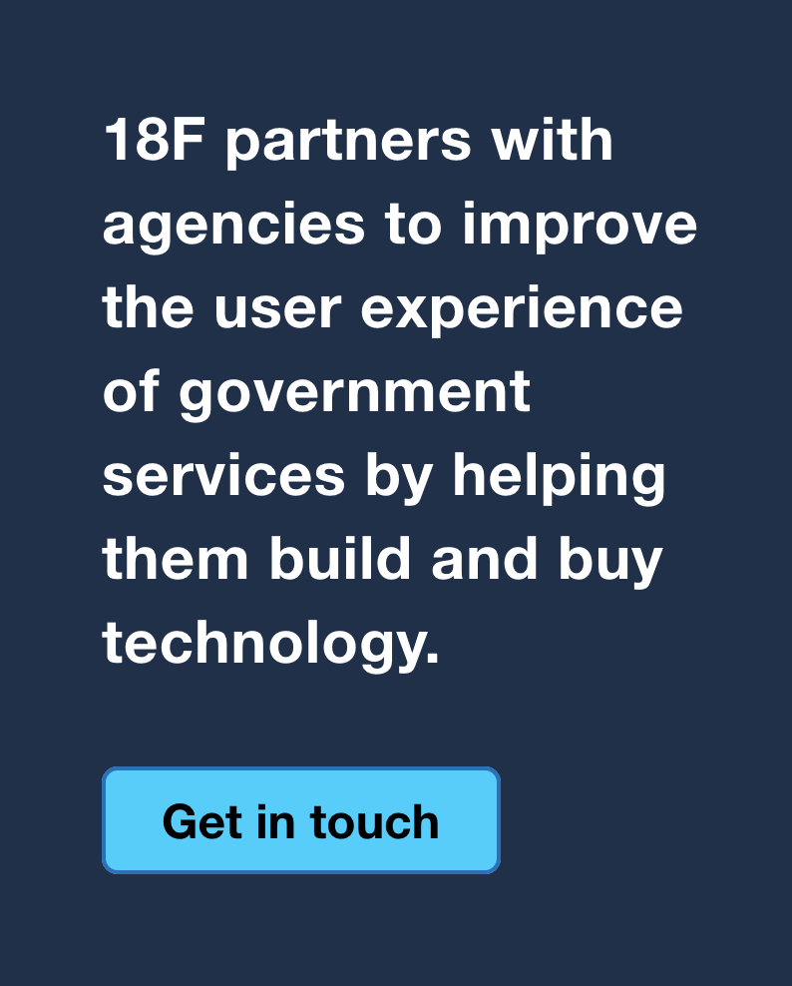
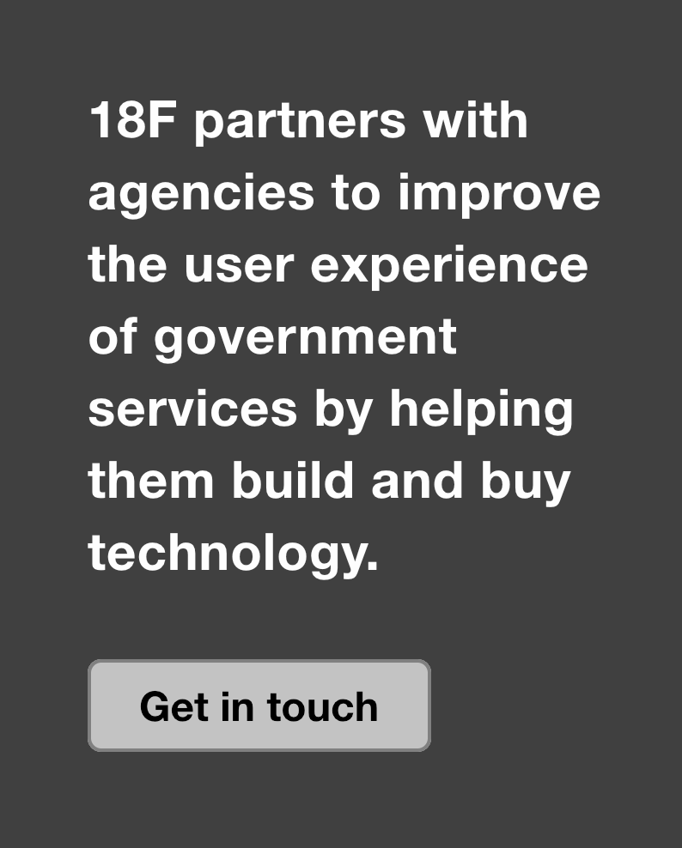
Good example – color and monochrome still perceivable
This design is very readable, regardless of color perception
Full color vision
Monochromacy

Slide 34
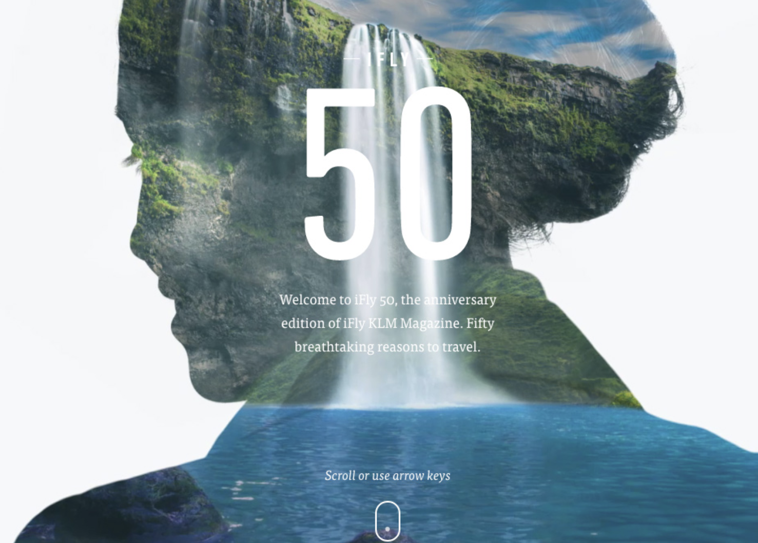
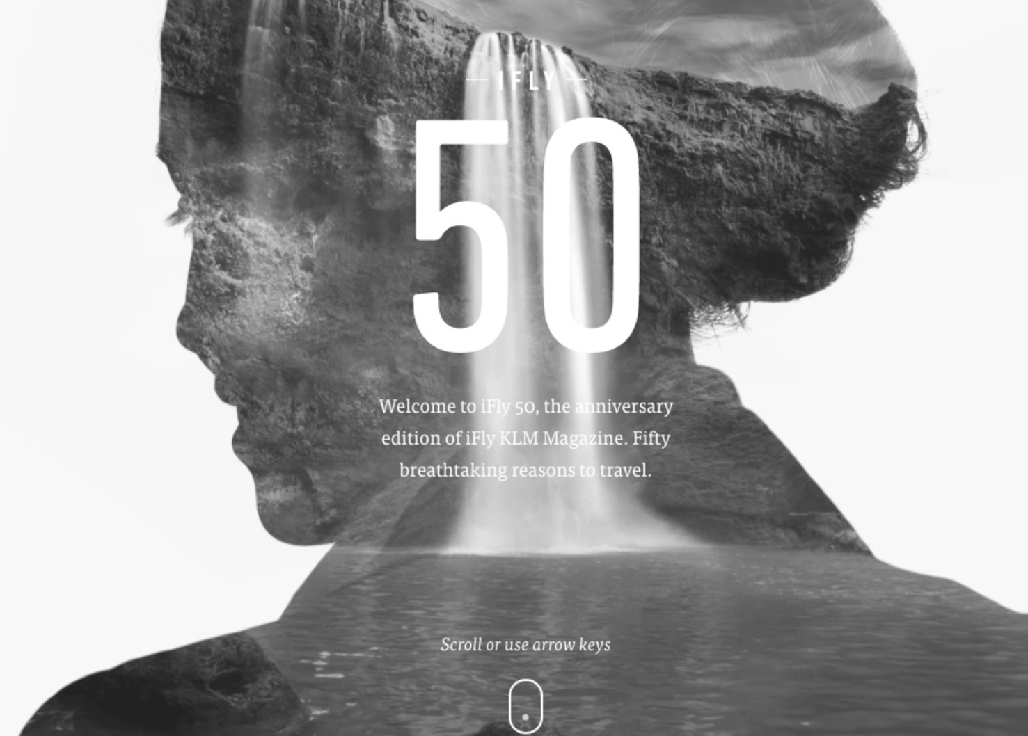
Bad example – monochrome design not legible
The design is beautiful, but the text is difficult to read because it has poor contrast against the background.
Full color vision
Monochromacy

Slide 35
Text
Notes:
Nikki / Pia

Slide 36
1/ Make sure that text is large enough for everyone to read.
Notes:
Nikki

Slide 37
2/ Use descriptive link text.
Notes:
Robert

Slide 38
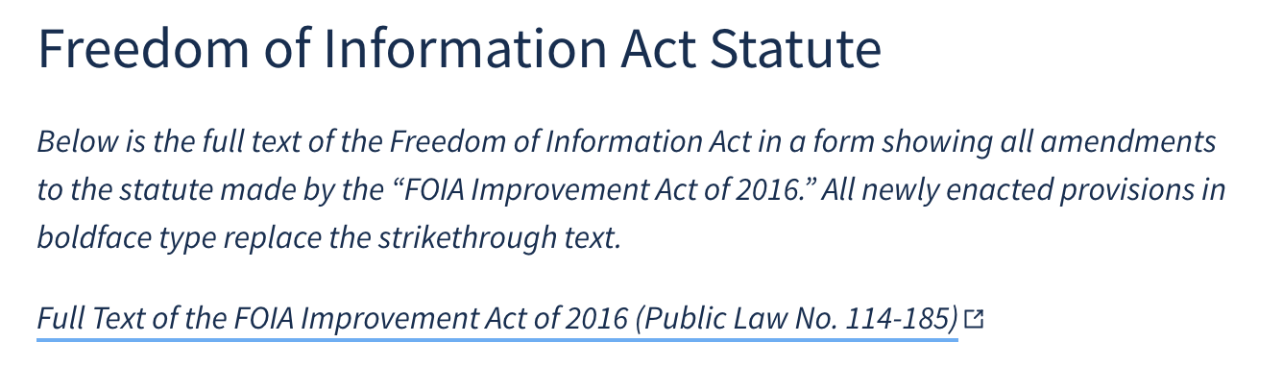
Good example – descriptive link text
The link text is descriptive so that a screen reader user will know exactly what to expect

Slide 39
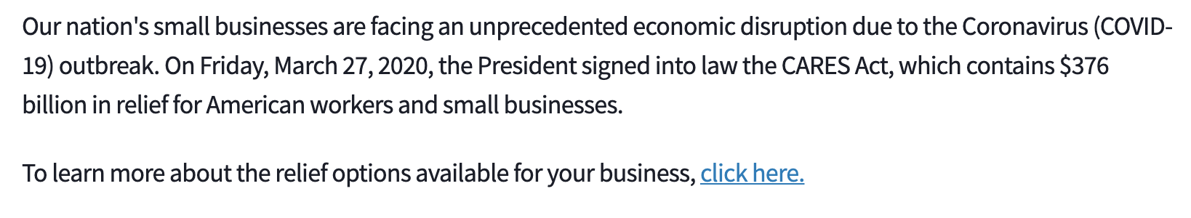
Bad example – link text is ambiguous
The link itself just says “click here” and is not informative for a screen reader user

Slide 40
How to test
Look at the text of the link and determine if the text describes the purpose of the link. If there is ambiguity, you’ve found an accessibility problem.
You can cite WCAG 2.4.4 Link Purpose (In Context) in your bug report.

Slide 41
3/ Use consistent labels and messaging
Notes:
Nikki

Slide 42
Many people need consistent labels and messaging to successfully complete online tasks. Inconsistency in design or labels can create confusion and increase our users’ cognitive load.

Slide 43
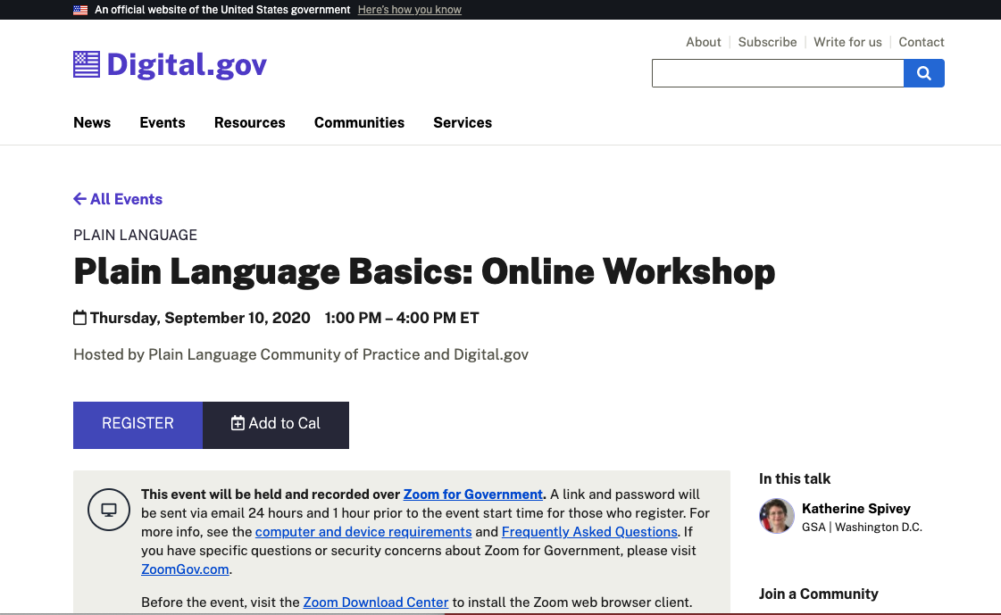
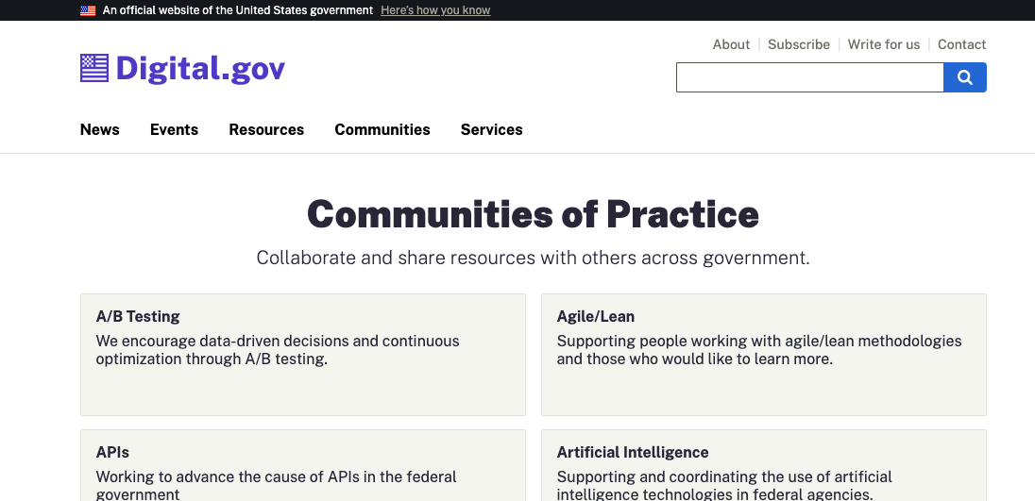
Good example – consistent design
Consistent labels and messaging - same text labels, icons, and design throughout site

Slide 44
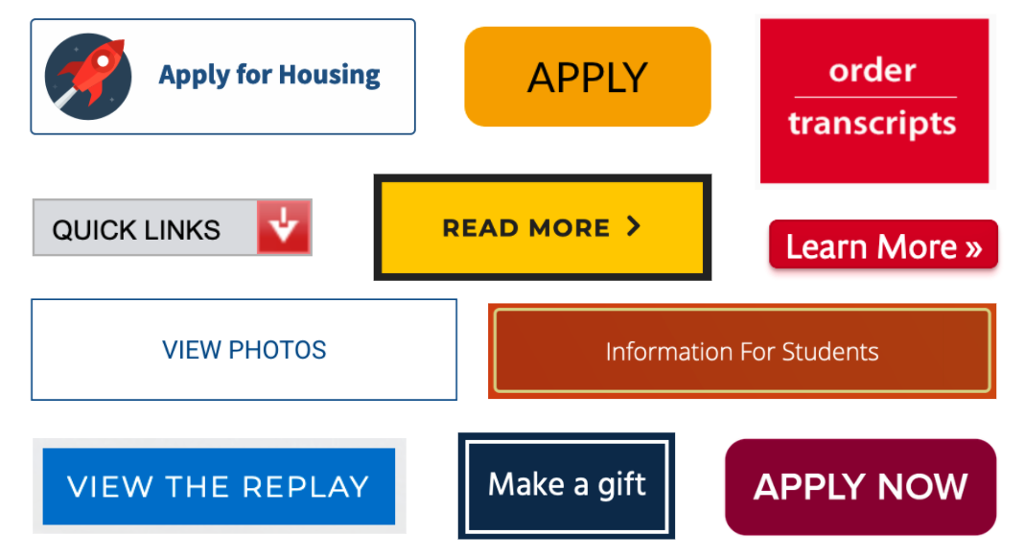
Bad example – inconsistent design of buttons
Inconsistent labels and messaging - all of these buttons were from the same university website

Slide 45
How to test
While looking at a site, take note of any instances of inconsistent labels (including alt text), iconography, or other design aspects which could cause confusion about meaning or functionality.
If any are found, you can cite WCAG 3.2.4 Consistent Identification in your bug report.

Slide 46
Cues and feedback
Notes:
Nikki / Claire

Slide 47
1/ Clearly communicate focus.
Notes:
Nikki

Slide 48
Interactive software should always accurately display focus. This is particularly important for anyone using keyboard navigation.

Slide 49
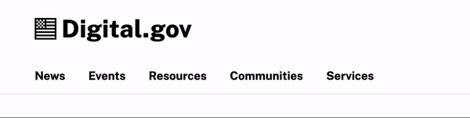
Good example – visible focus
Focus is clearly displayed as the user tabs through elements

Slide 50
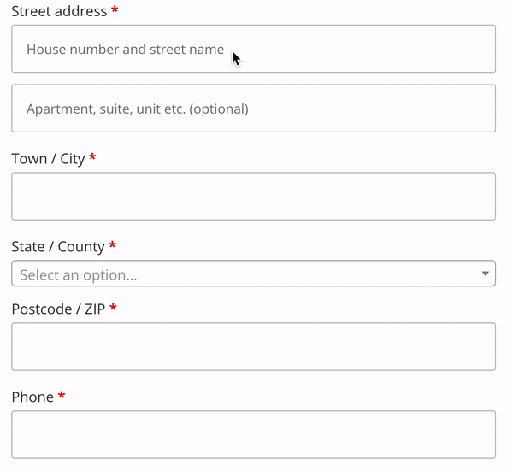
Bad example – visible focus lacking
Focus is not shown when the dropdown is selected, which can disorient users

Slide 51
How to test
Tab through the site’s links, buttons, and form elements. Is there a visible focus indicator (outline, background/foreground change, other visible cue)?
If there are any instances where there is no focus indicator or it is too subtle to clearly see? If so, you can cite WCAG 2.4.7 Focus Visible in your bug report.

Slide 52
2/ Avoid flickering, jarring, or rapid-moving animations.
Notes:
Robert

Slide 53
At their most harmless, poorly thought out animations are distracting. At their worst, they can cause motion sickness, disorientation, and even seizures.

Slide 54
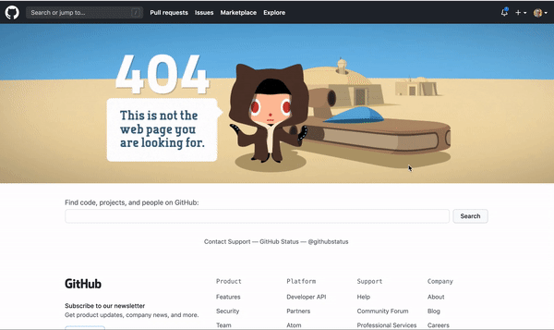
Good example – appropriate animation
GitHub’s 404 page responds to the cursor and search field focus, putting the user in control of the animation

Slide 55
Warning: flicker

Slide 56

Bad example – animation with flickering imagery
Bad animation

Slide 57
Warning: vertigo, motion sickness

Slide 58
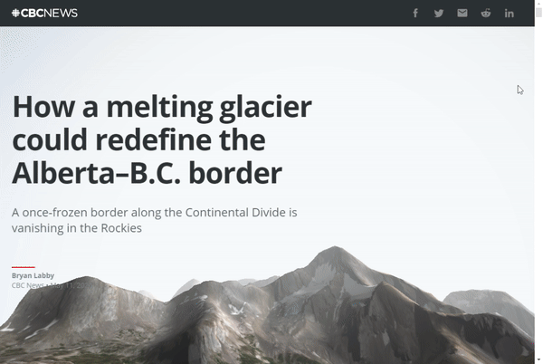
Bad example – animation that causes vertigo
While this visualization is neat, it’s also disorienting and gives some people motion sickness.

Slide 59
How to test
Review the page/site visually for flashing and moving content.
Flashing: Are there any instances where content flashes more than three times per second? If so, you can cite WCAG 2.3.1 Three Flashes or Below Threshold in your bug report.
Motion/Animation: Is there any significant motion on the page where there is no way to disable it? If so, you can cite WCAG 2.3.3 Animation from Interactions in your bug report.

Slide 60
3/ Don’t rely on audio cues alone.
Notes:
Nikki

Slide 61
Not everyone can hear your website! And whether or not they can hear, unexpected noises can be disruptive, embarrassing, or stressful.

Slide 62
If your website has audio content, you should use additional cues to signal that there is sound. You should also give users control over the sound.

Slide 63
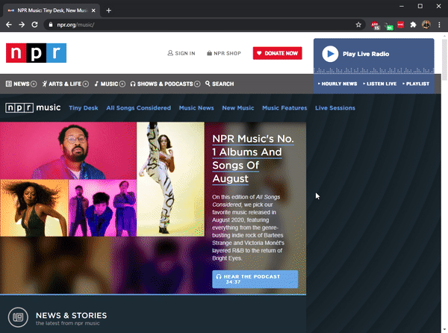
Good example – user controlled audio
NPR doesn’t play back recordings automatically, giving the user control

Slide 64
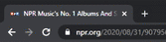
Good example – browser tab with audio indicator
And the web browser displays an icon to signal that sound is playing in a particular tab

Slide 65
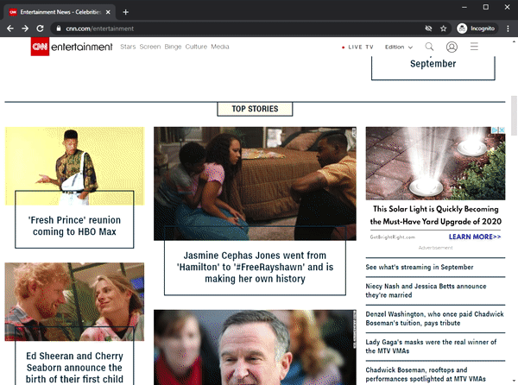
Bad example – audio that autoplays
CNN automatically plays videos with (ads and music) when you open an article

Slide 66
How to test
Audio-only information or cues: If any content or interaction relies on audio alone, you can cite WCAG 1.3.3 Sensory Characteristics in your bug report.
Sound without the ability to pause/turn off: If any audio is playing that cannot be turned off (or paused) using an accessible control, then you can cite WCAG 1.4.2 Audio Control in your bug report.

Slide 67
Managing input
Notes:
Robert / Pia

Slide 68
1/ Give users as much time as possible.
Notes:
Robert

Slide 69
Arbitrary time limits are bad for folks with motor impairments, cognitive disabilities like dyslexia, and folks with anxiety and other psychological disabilities.

Slide 70
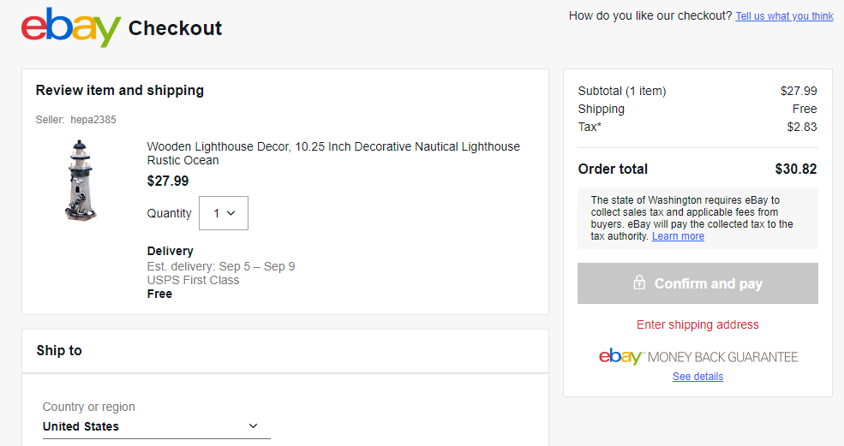
Good example – no time limit
eBay gives users an indefinite amount of time to finish the checkout process

Slide 71
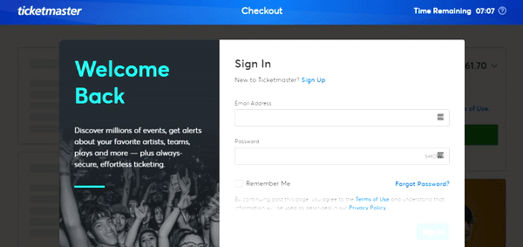
Bad example – very short time limit
Ticketmaster forces users to rush through their checkout flow, with a running timer that heightens anxiety

Slide 72
How to test
If any content or interaction has a time limit, ensure that one of the following is true:
Users can turn off the timer, adjust the length of the timer (at least 10 times the default), or extend the timer at least 10 times (with 20 seconds or more notice, using a simple mechanism).
If none of those features are present, cite WCAG 2.2.1 Timing Adjustable in your bug report.
Note: This rule does not apply for timers more than 20 hours in length or when the timer is deemed essential.

Slide 73
2/ Don’t force users to be precise in their inputs.
Notes:
Nikki

Slide 74
Small links, buttons, or other controls can be difficult for folks to find and activate. Be generous with sizing and spacing to allow for easier use of your product/site.

Slide 75
Avoid requiring specific keystrokes or gestures to accomplish tasks. These can be difficult for many reasons, especially for those with cognitive or motor disabilities.

Slide 76
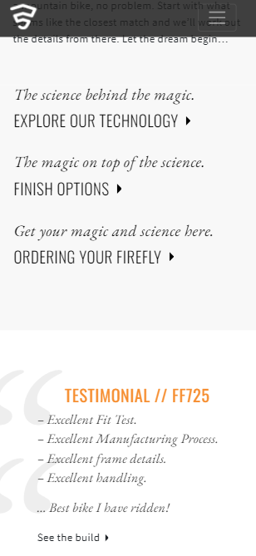
Good example – large link target sizes
The call to action links and navigation icons and large and forgiving

Slide 77
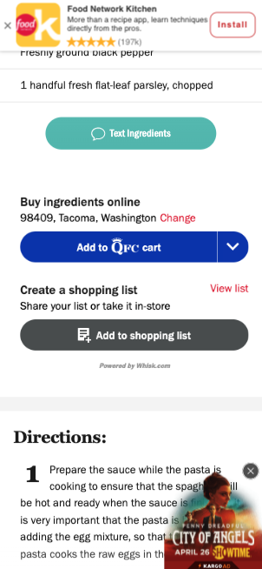
Bad example – tiny link target sizes
Close buttons on all the ads are tiny, and much harder to target than calls to action!

Slide 78
[exception: you’re building a game]

Slide 79
[however, even in games, each input method is treated differently to account for varying levels of precision!]

Slide 80
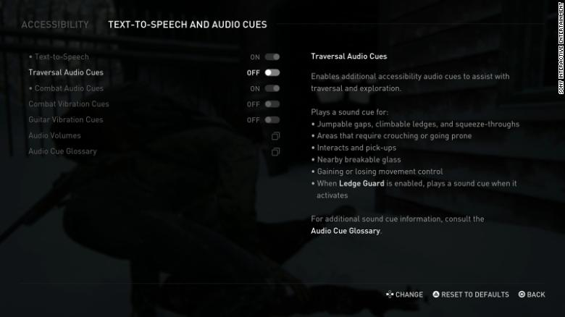
Screenshot of accessibility controls in game

Slide 81
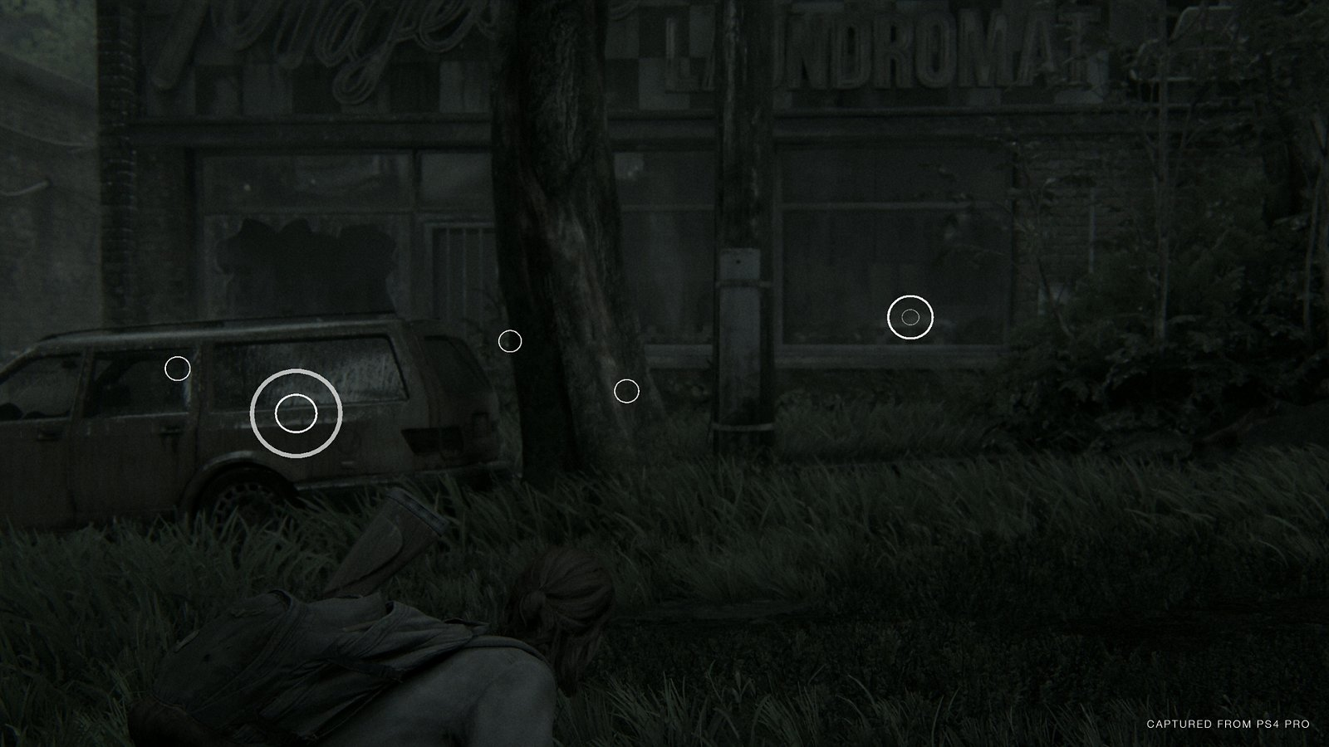
Screenshot of larger hit targets in game

Slide 82
How to test
Review the page for any content or interaction available only through specific keystrokes or gestures, if target sizes are smaller than 44 by 44 pixels, or if motion is required to activate features.
If you find any instances, you can apply the appropriate success criteria from 2.5 Input Modalities in your bug report. These will likely be one (or more) of the following:
WCAG 2.5.1 Pointer Gestures
WCAG 2.5.4 Motion Actuation
WCAG 2.5.5 Target Size

Slide 83
Questions?
Notes:
Claire

Slide 84
Homework
Notes:
Robert

Slide 85
Assignment #7:
We have a website for you to assess. Don’t spend more than 1 hour.
Take a look at this webpage. What design choices have they made, and how do those choices impact accessibility? What usability issues do you notice?
Now run a 3-part audit on the site. What problems do you find?

Slide 86
Thanks!
Slack #g-accessibility

